Slide 1



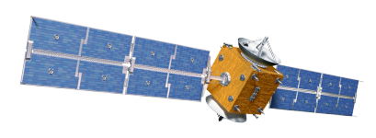
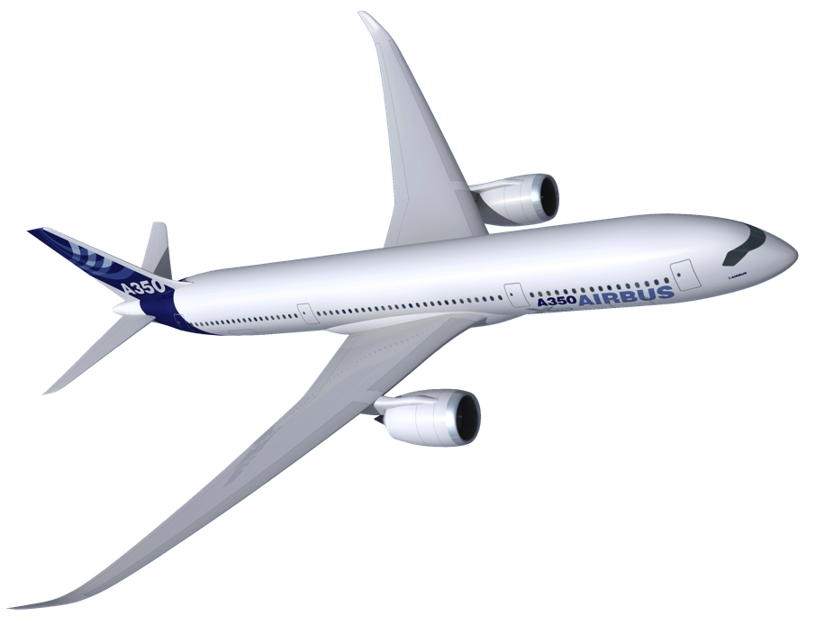






Slide 2





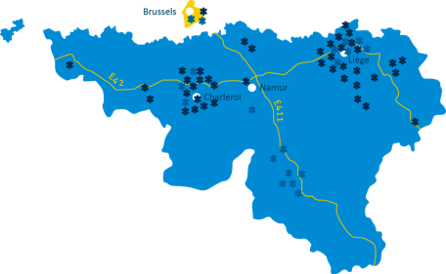
ACTING TOGETHER
The aerospace cluster 'Skywin Wallonia' is
a group of Walloon companies, training centers and research units involved in aeronautical and space sectors
engaged in public and private partnership
building synergies around common and innovative projects

Slide 3

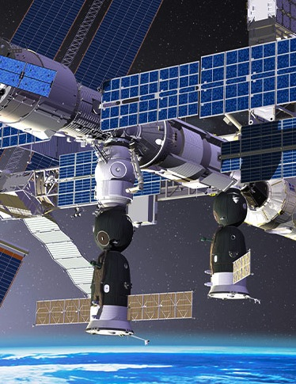
overview
AERONAUTICS
SPACE
Walloon Aeronautics Industry: 120 members
Turnover: ± 1350 Million €
Employment: 5400 jobs
Walloon Space Industry: 36 members
Turnover: ± 250 Million €
Employment: 1600 jobs

Slide 4
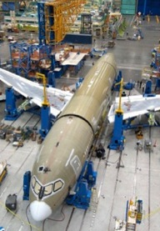
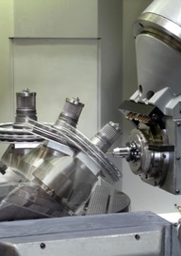
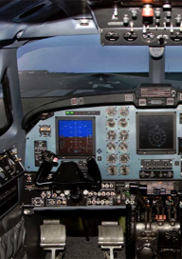
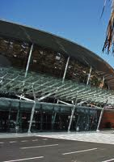

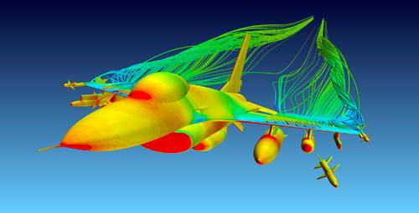
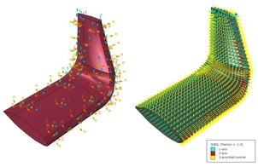
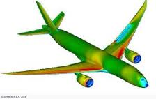
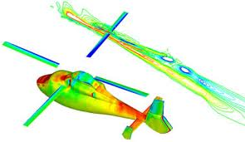
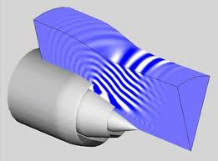
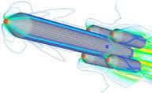
Strategic axis
Composite materials and processes
Metallic materials
and processes
Embedded systems
Airport services
Space and Drones applications
and systems
Develop competences
Process automation
Increase production capacity
Importing mature technologies
Stabilize competences
Process automation
Increase competitiveness
Develop new competences (Additive Manufacturing)
Opening for other sectors
Integrated services products
Payloads/Sensors for Drones and associated electronics
Structural Health Monitoring
Strong link with Space
Technological link betw.
2 regional airports
and SME’s
Develop an offer :
« Airport competences »
for emerging markets
Develop integrated
and original offer :
mini-satellites in
Emerging markets.
Strongly market oriented
Drone market
Modeling and Simulation (transverse axis)
Develop an offer integrating multi-physics
Maintain competences in Wallonia and participate to market growth

Slide 5
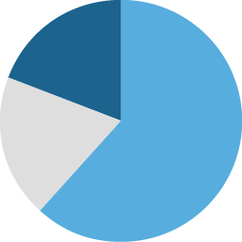
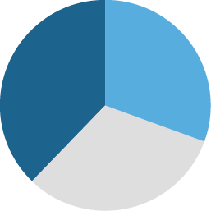
a few numbers
152 Members in 2016 (86 in 2006) 118 Enterprises (with 86 SME); 34 Universities, Research Centers and training Centers
72 labelized projects over 18 Calls (2007-2016)
    43 R&D Projects 180M€
    19 Investment Projects 30 M€
    10 Training Projects 15 M€
    Total budget: 225 M€
    Private budget (from Industry): 81 M€
    Public funding (for Research & Education): 65 M€
    Public funding (for Industry): 79 M€

Slide 6

Aeronautical activities
A Short overview

Slide 7
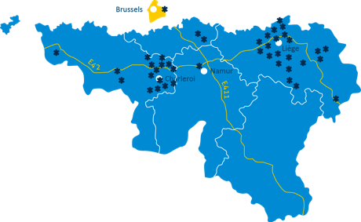



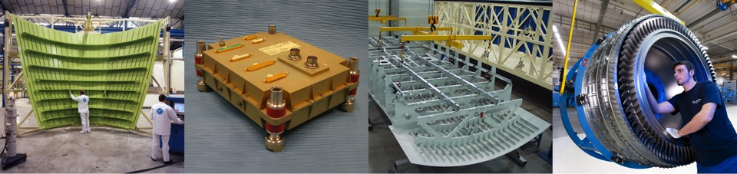
Aerospace companies overview
Aeronautical Companies
  Large companies
    SAFRAN Aero Booster
      World leader for Boosters for Med- and Long-Haul aircrafts
    SONACA
      World leader for Fixed and Moveable Leading Edges
    S.A.B.C.A
  Large and dynamic network of SME’s

Slide 8
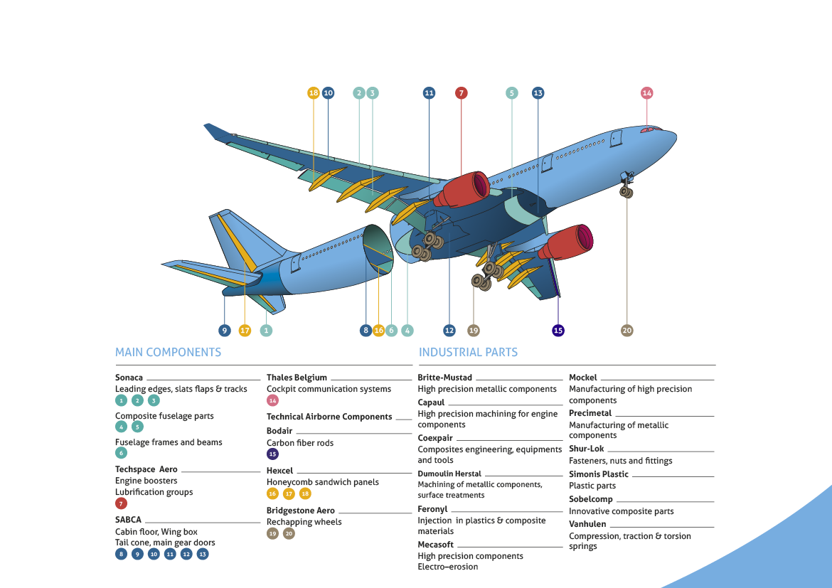
SKYWIN SHARE IN CIVIL
AIRCRAFT PARTS

Slide 9
Focus on
SPACE activities

Slide 10
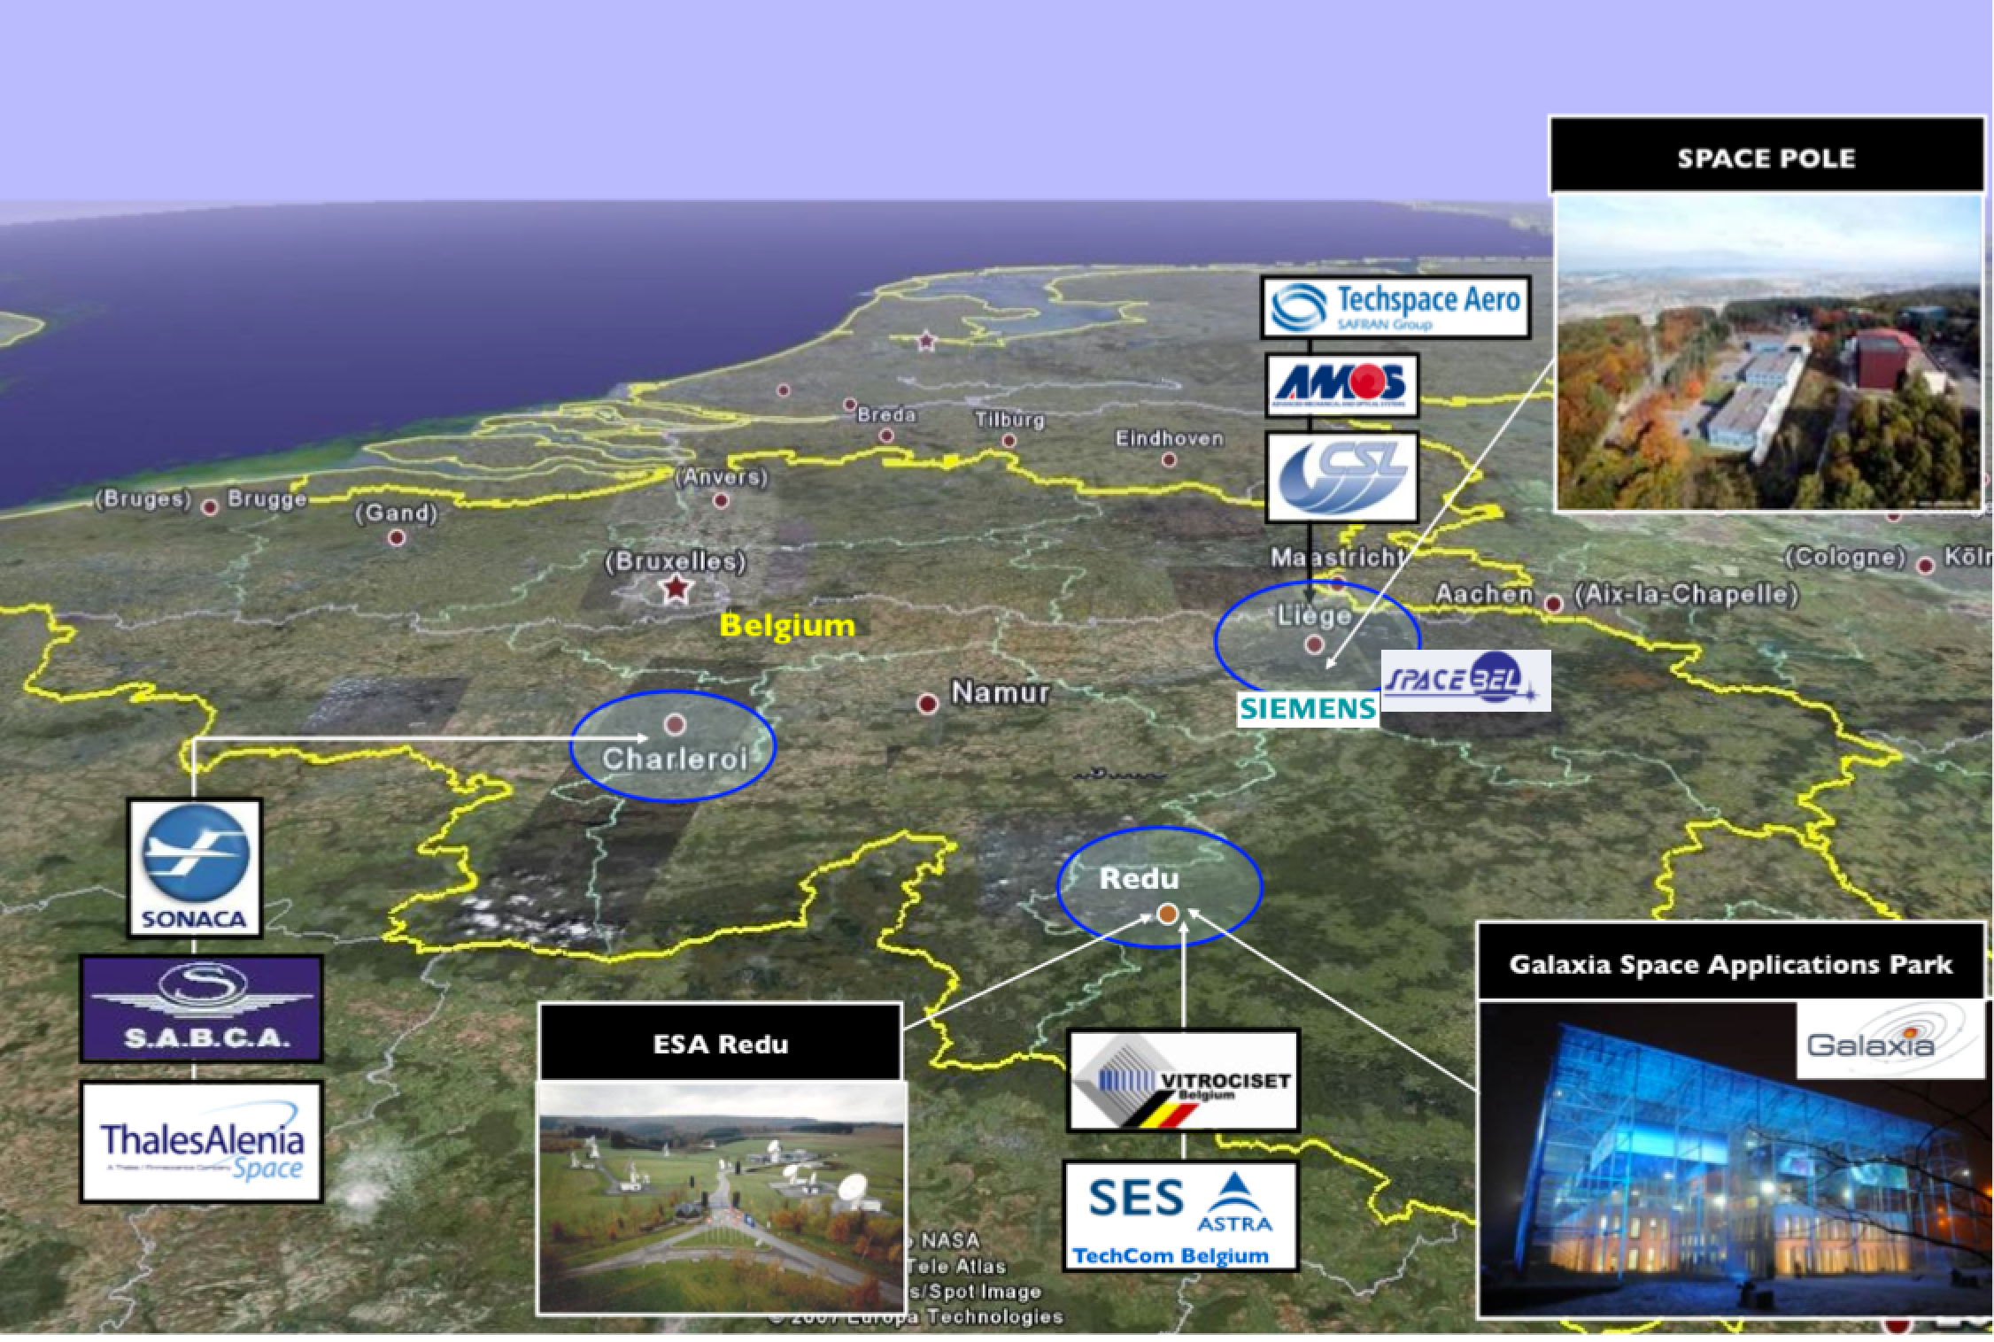
Focus on
SPACE activities

Slide 11
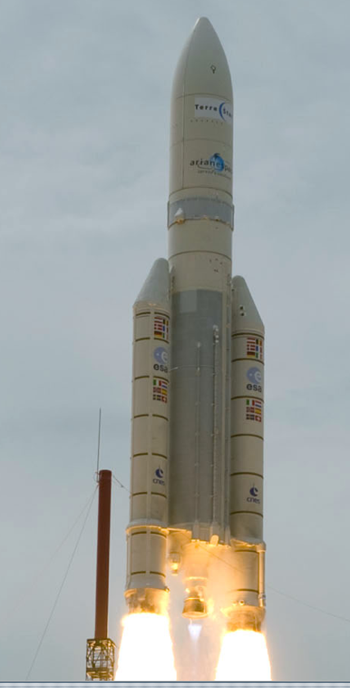
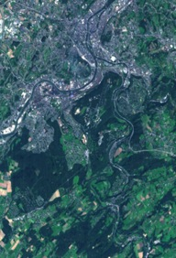
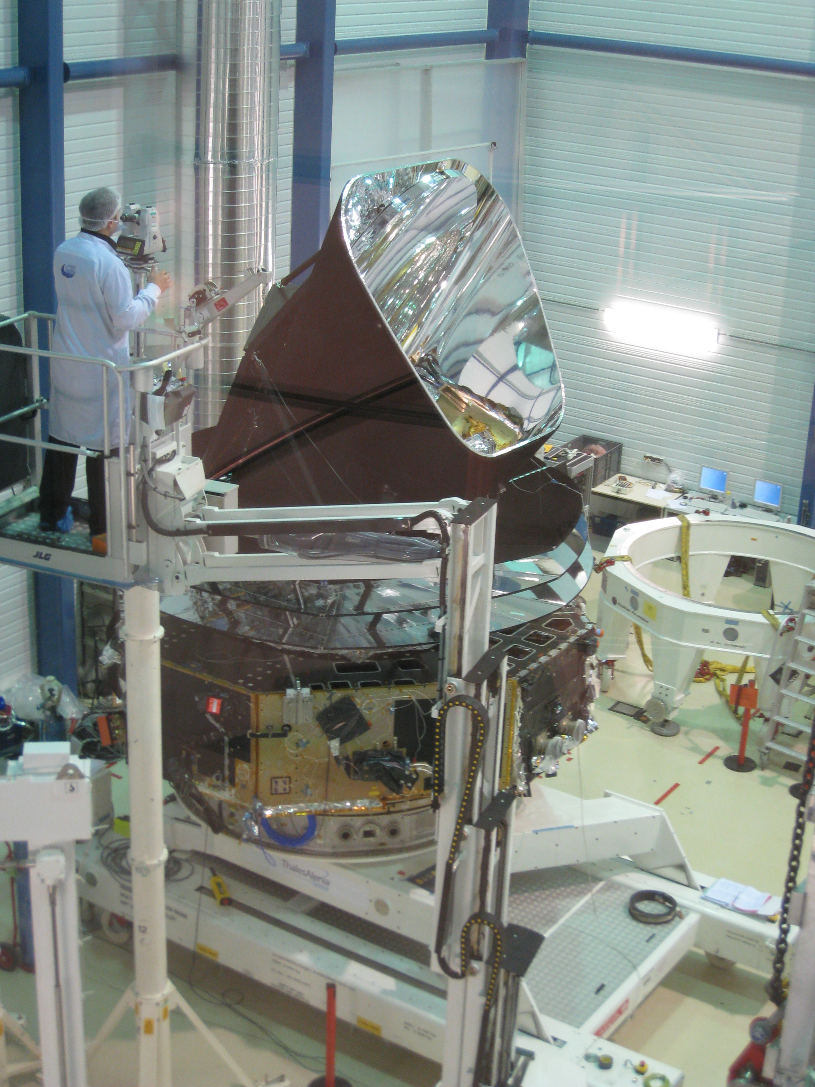
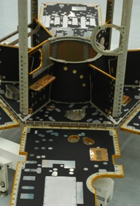
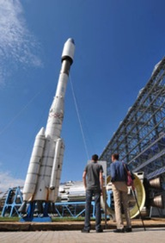
MAIN SEGMENTS
Ground Equipement
& Preparation
for space
In Orbit
Space
Education
Access
to Space
Exploitation
& Space
Applications

Slide 12
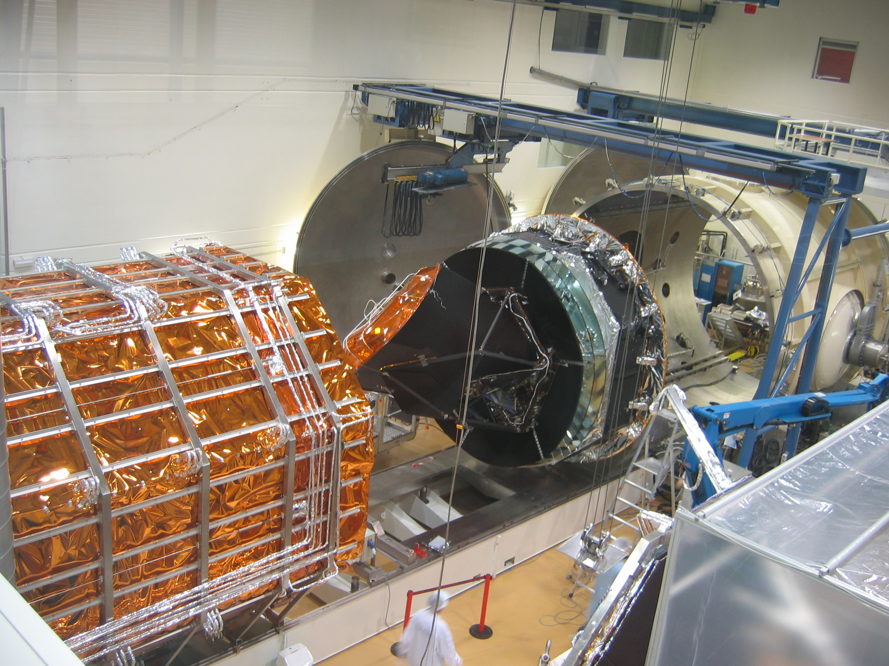
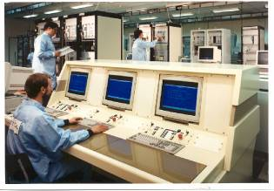
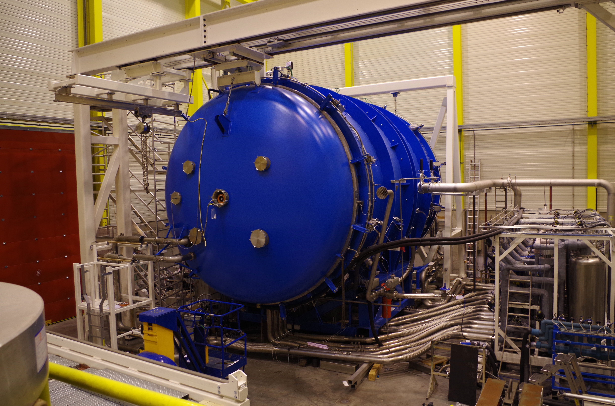
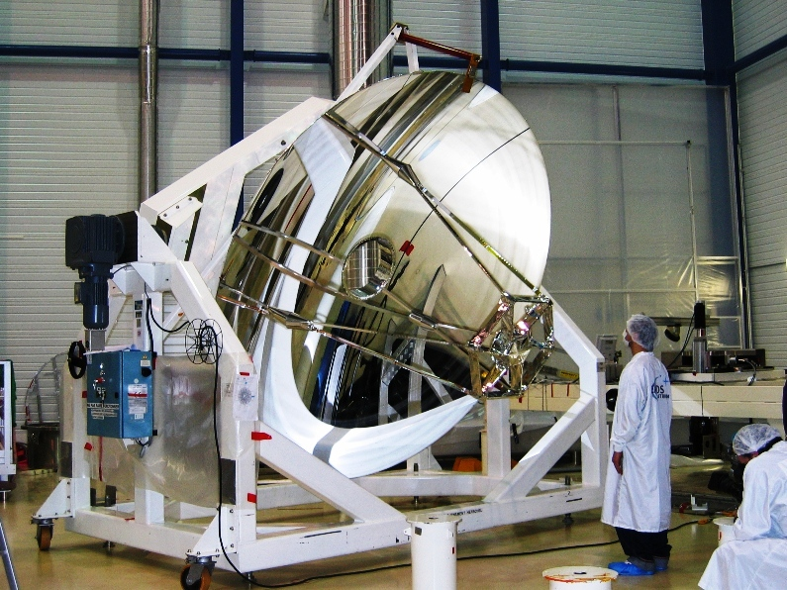
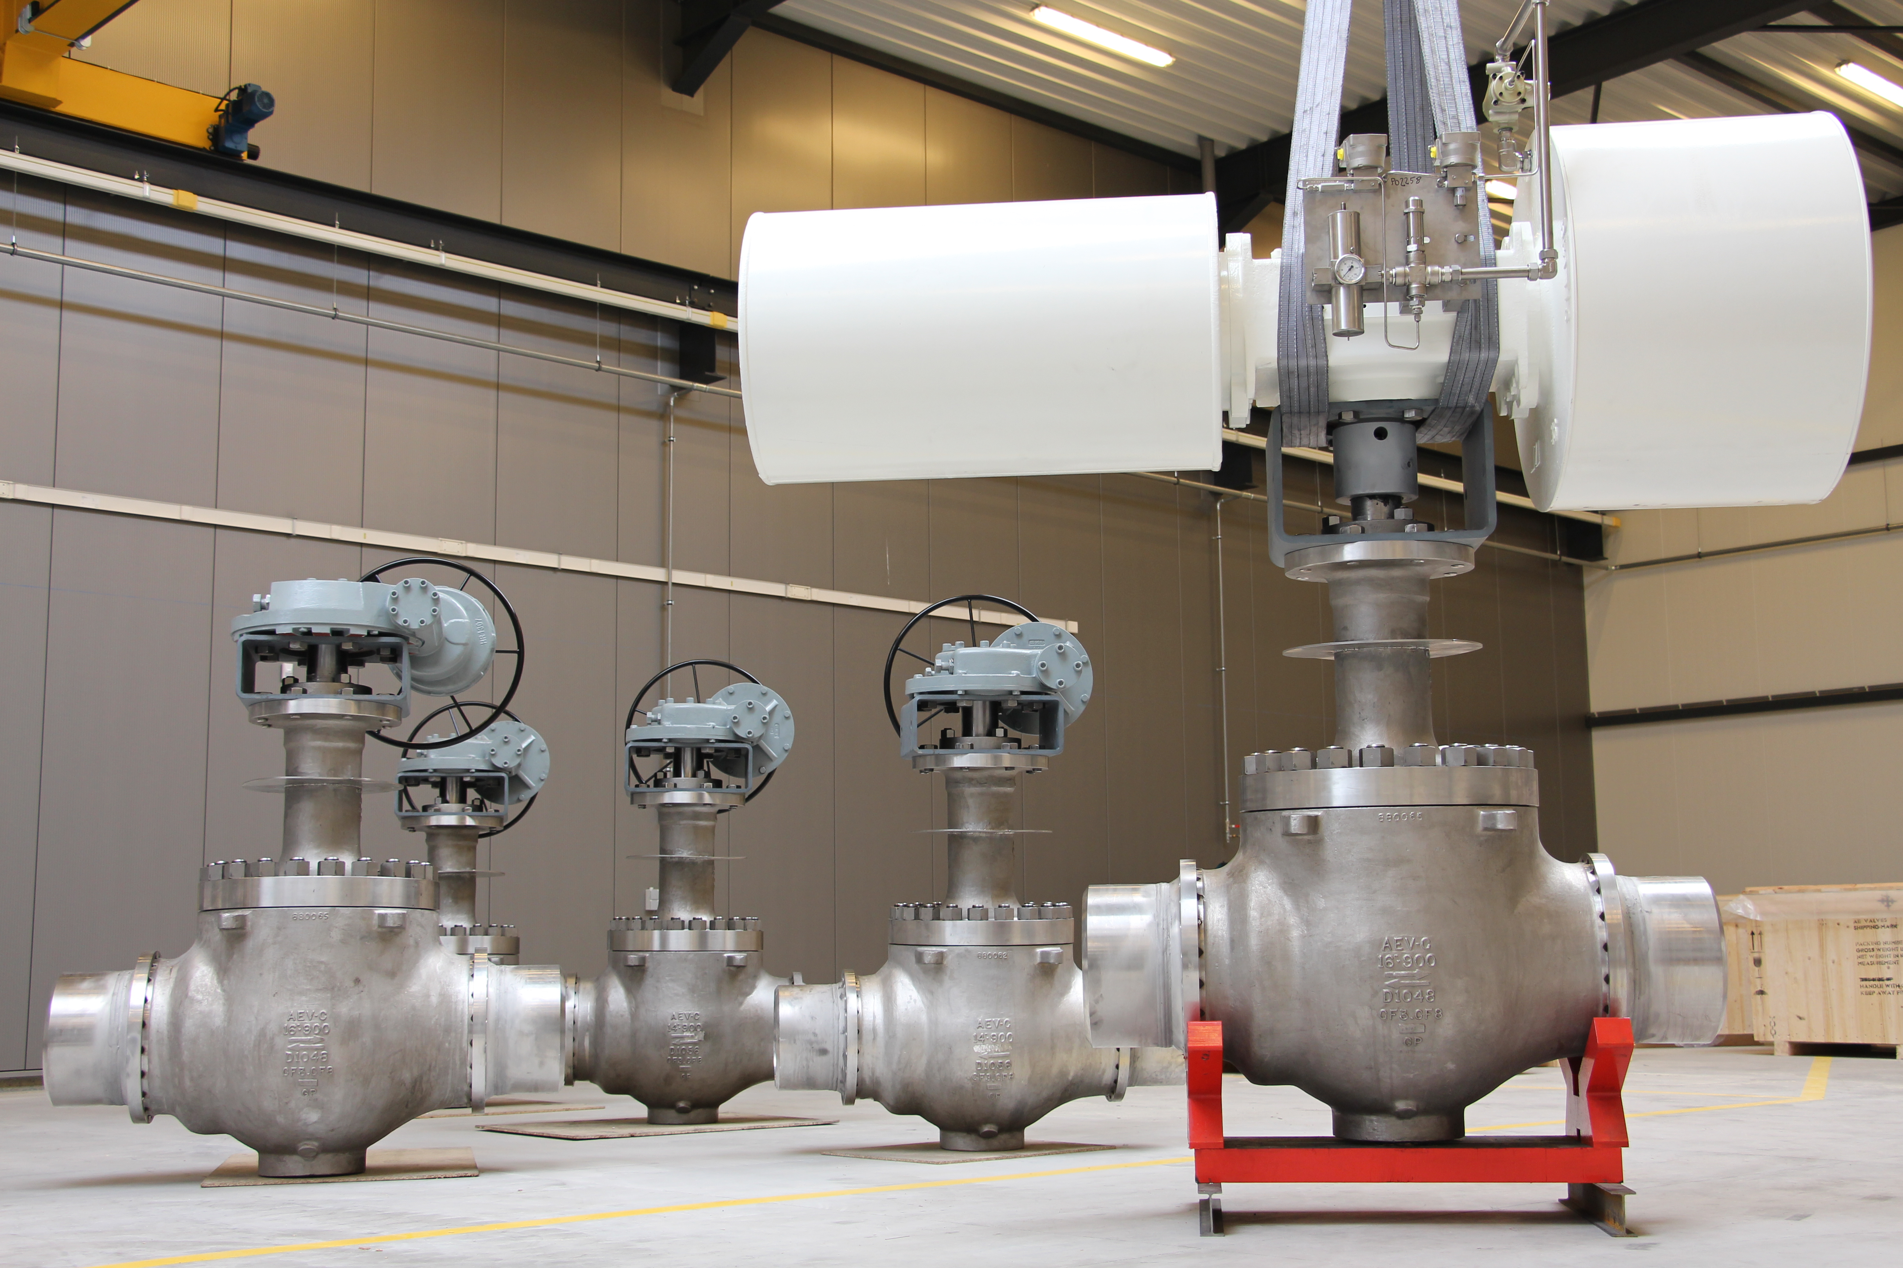
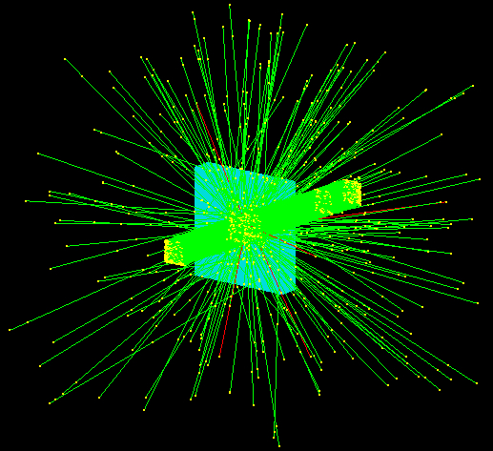
SPACE activities
Ground equipment & preparation for space
Simulation for space conditions
CSL, AMOS,..
Mission analysis & definition
Spacebel
TAS Belgium
Check out systems for launchers, test bench, Harsh environment testing,…
Cegelec, SP3, Incize, CSR , Timelink, AE-Valves, …

Slide 13
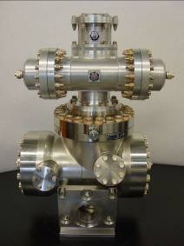
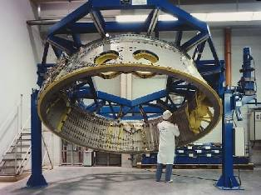
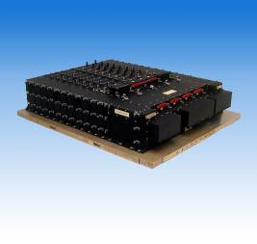
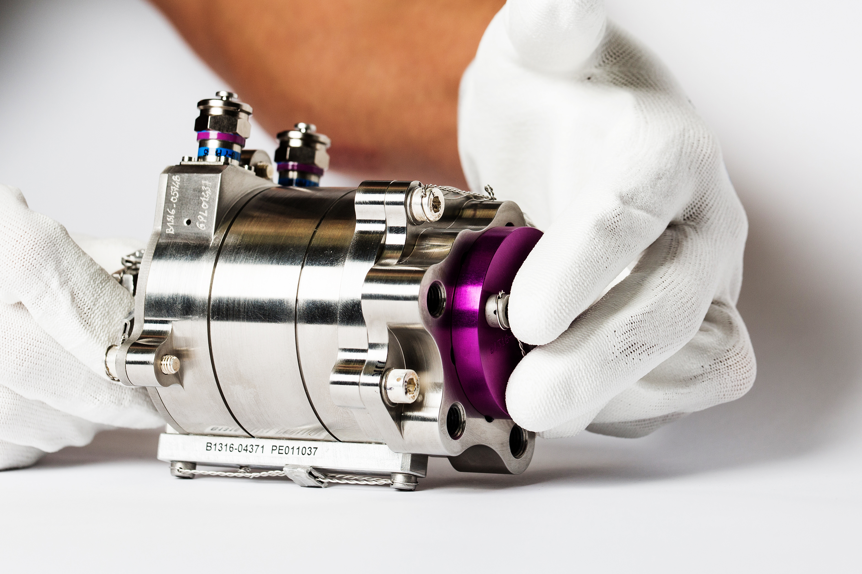
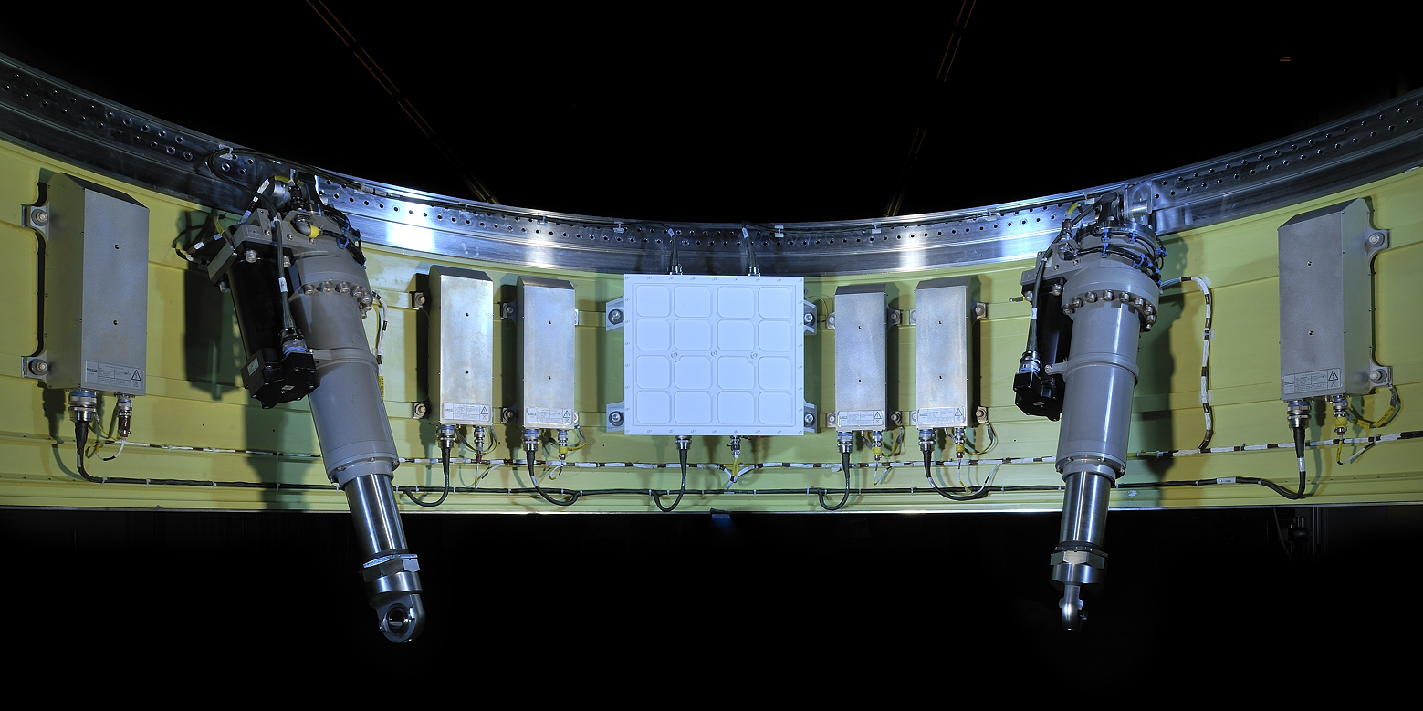
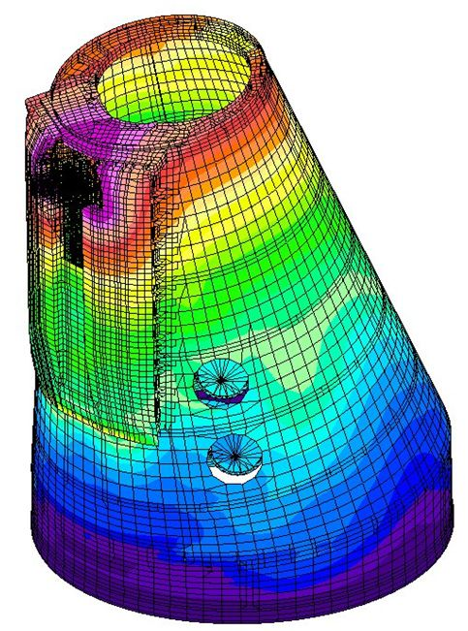
SPACE activities
Access to space
Launchers : structure & propulsion
Techspace Aero
SABCA
Power conditioning & distribution
TAS Belgium
Spacebel, Samtech, Rhea System, Open Engineering, GD Tech, Siemens,…
Software, engineering and operation

Slide 14
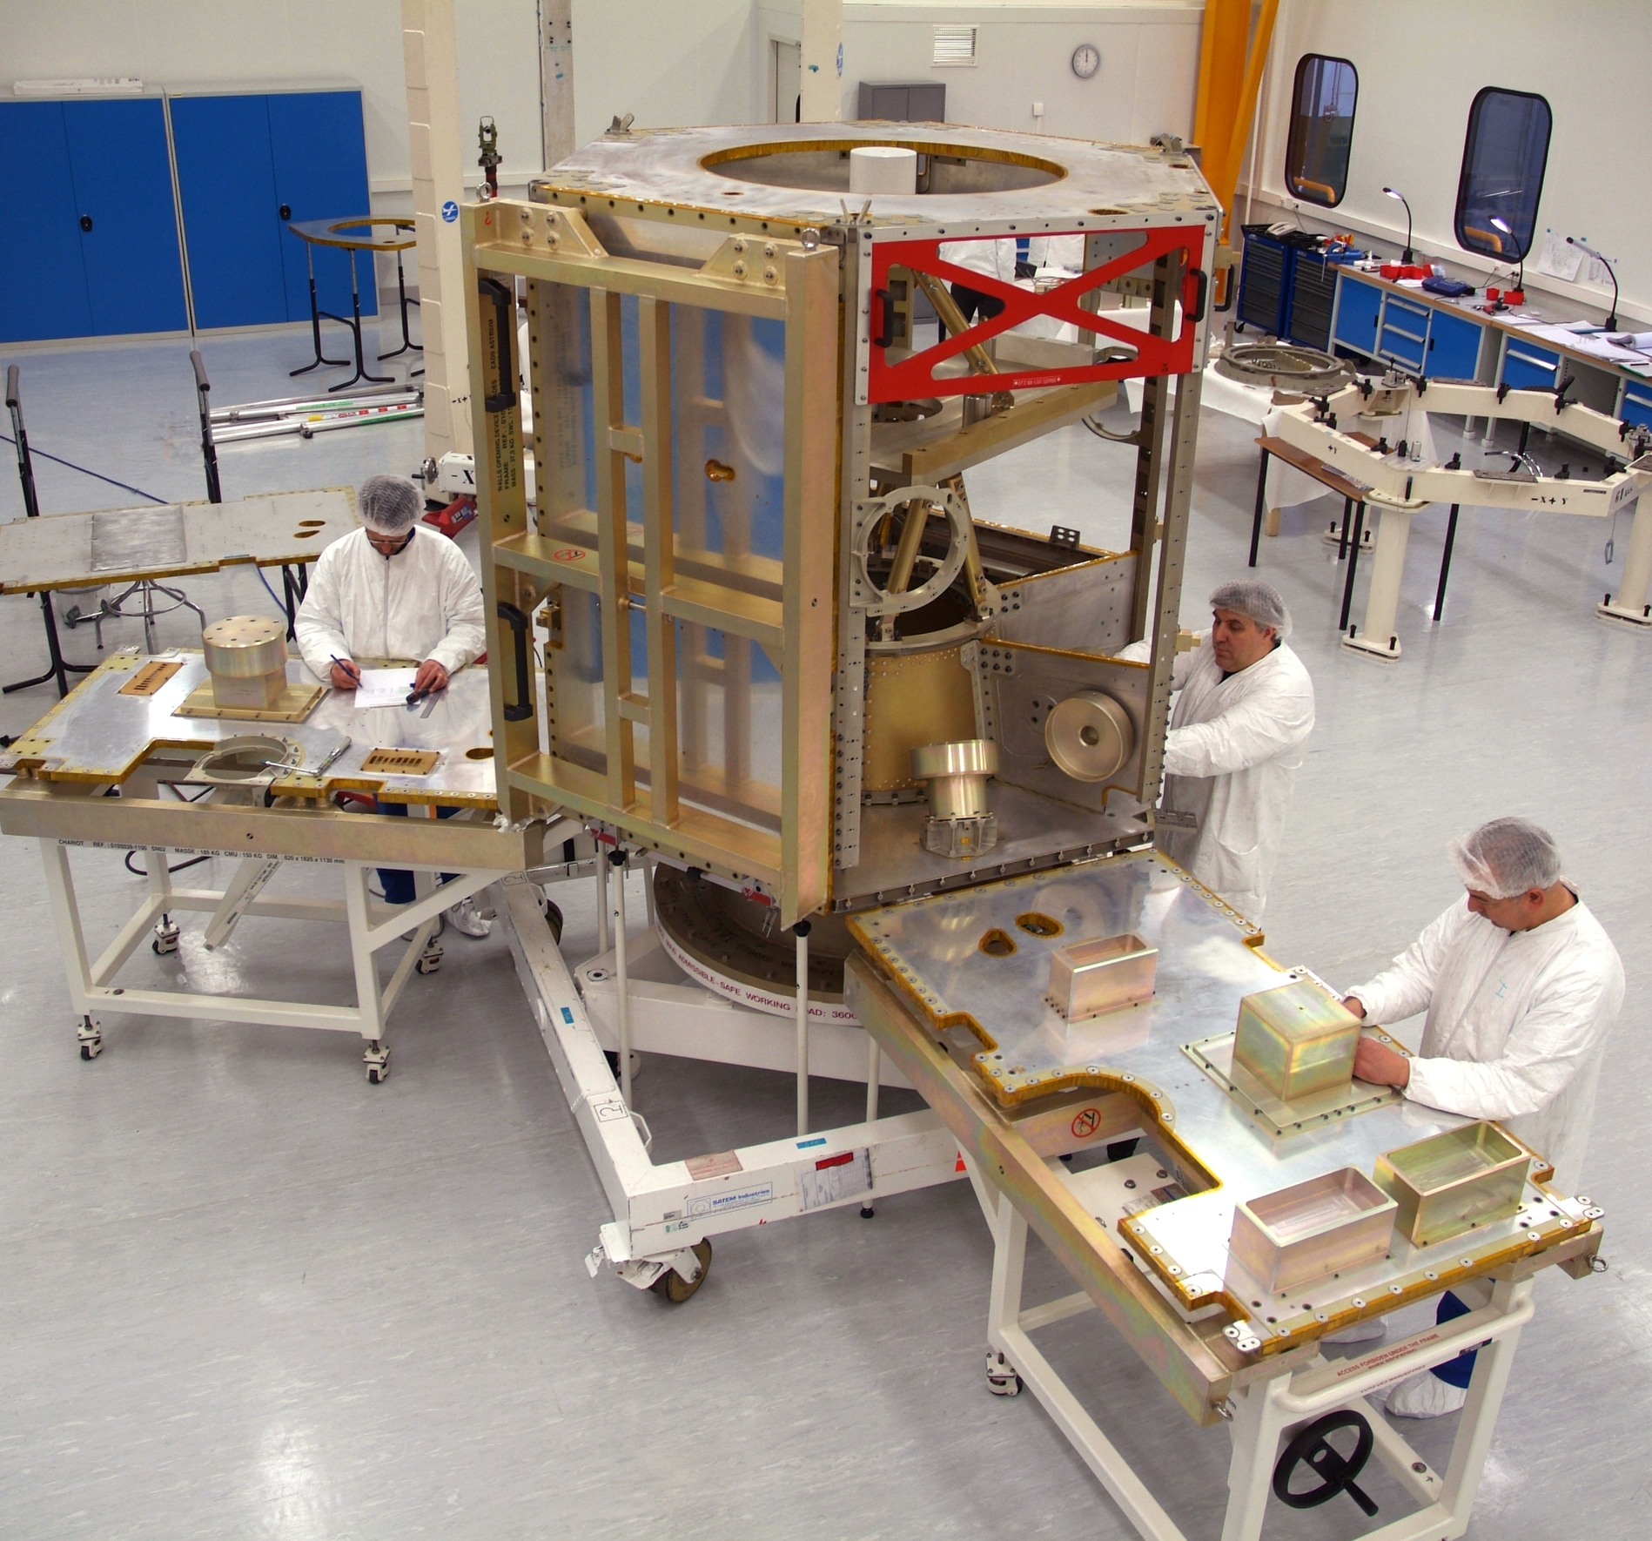
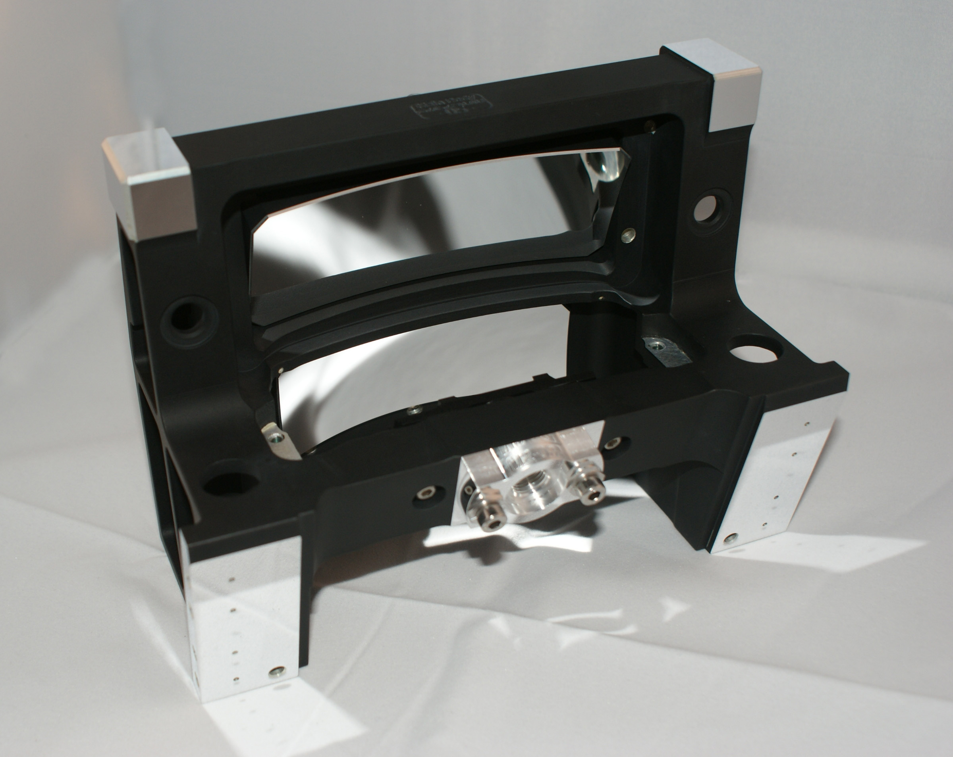
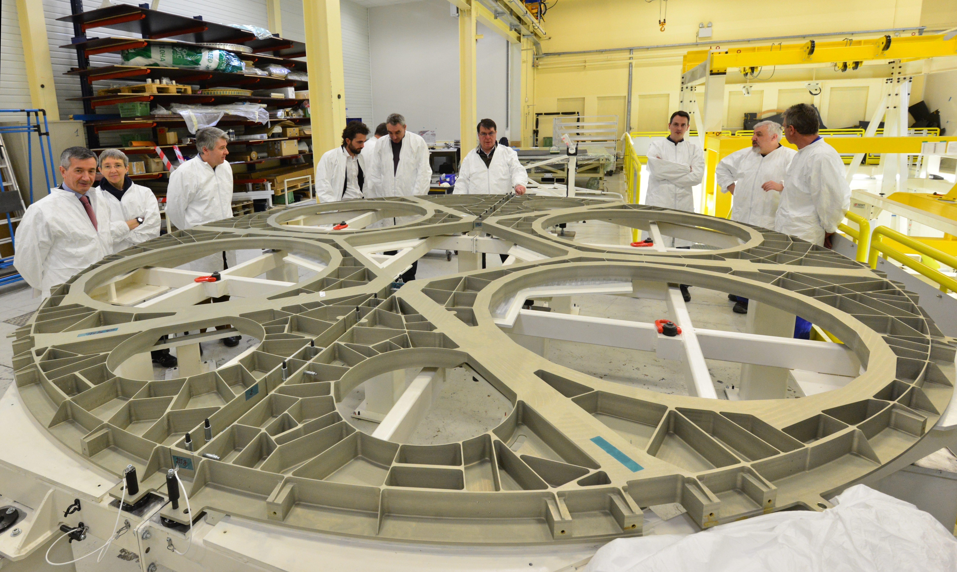
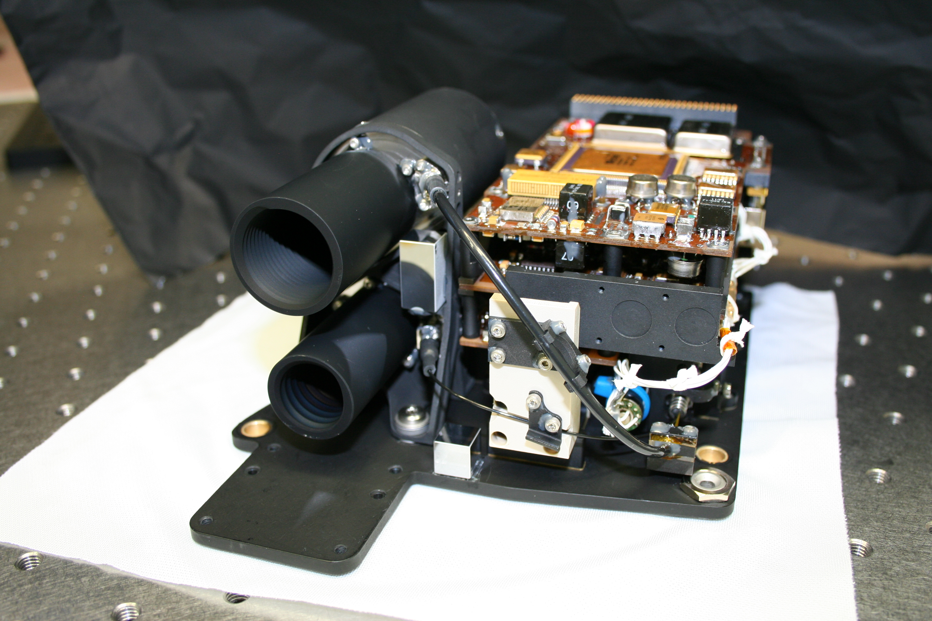
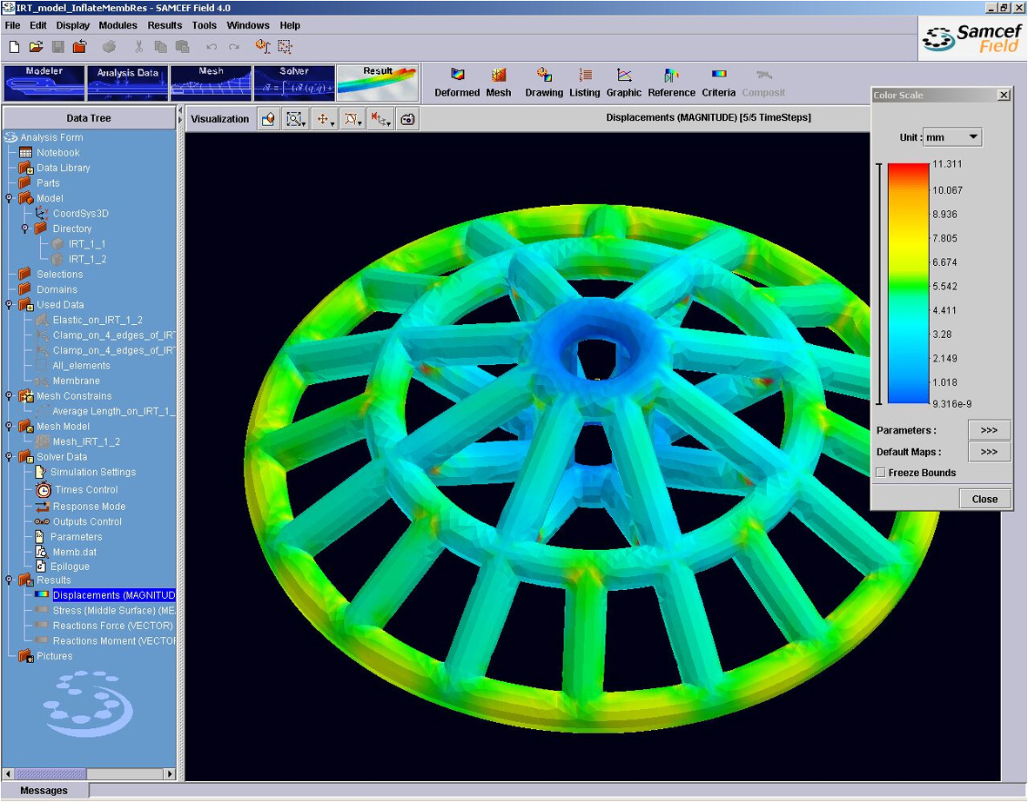
SPACE activities
In orbit
Platforms (Structure, propulsion, heat pipes,..)
SONACA, Techspace Aero, EHP
Power conditioning, atomic clocks, electronics
TAS Belgium, Gillam-FEI, Deltatec, Hipperos, Nsilition, Incize
Instruments (scientific, observation, meteo,...)
AMOS, CSL, Lambda-X, CSR,…
Software & engineering
SPACEBEL, SAMTECH, Rhea, Aethis
NEXT >

Slide 15
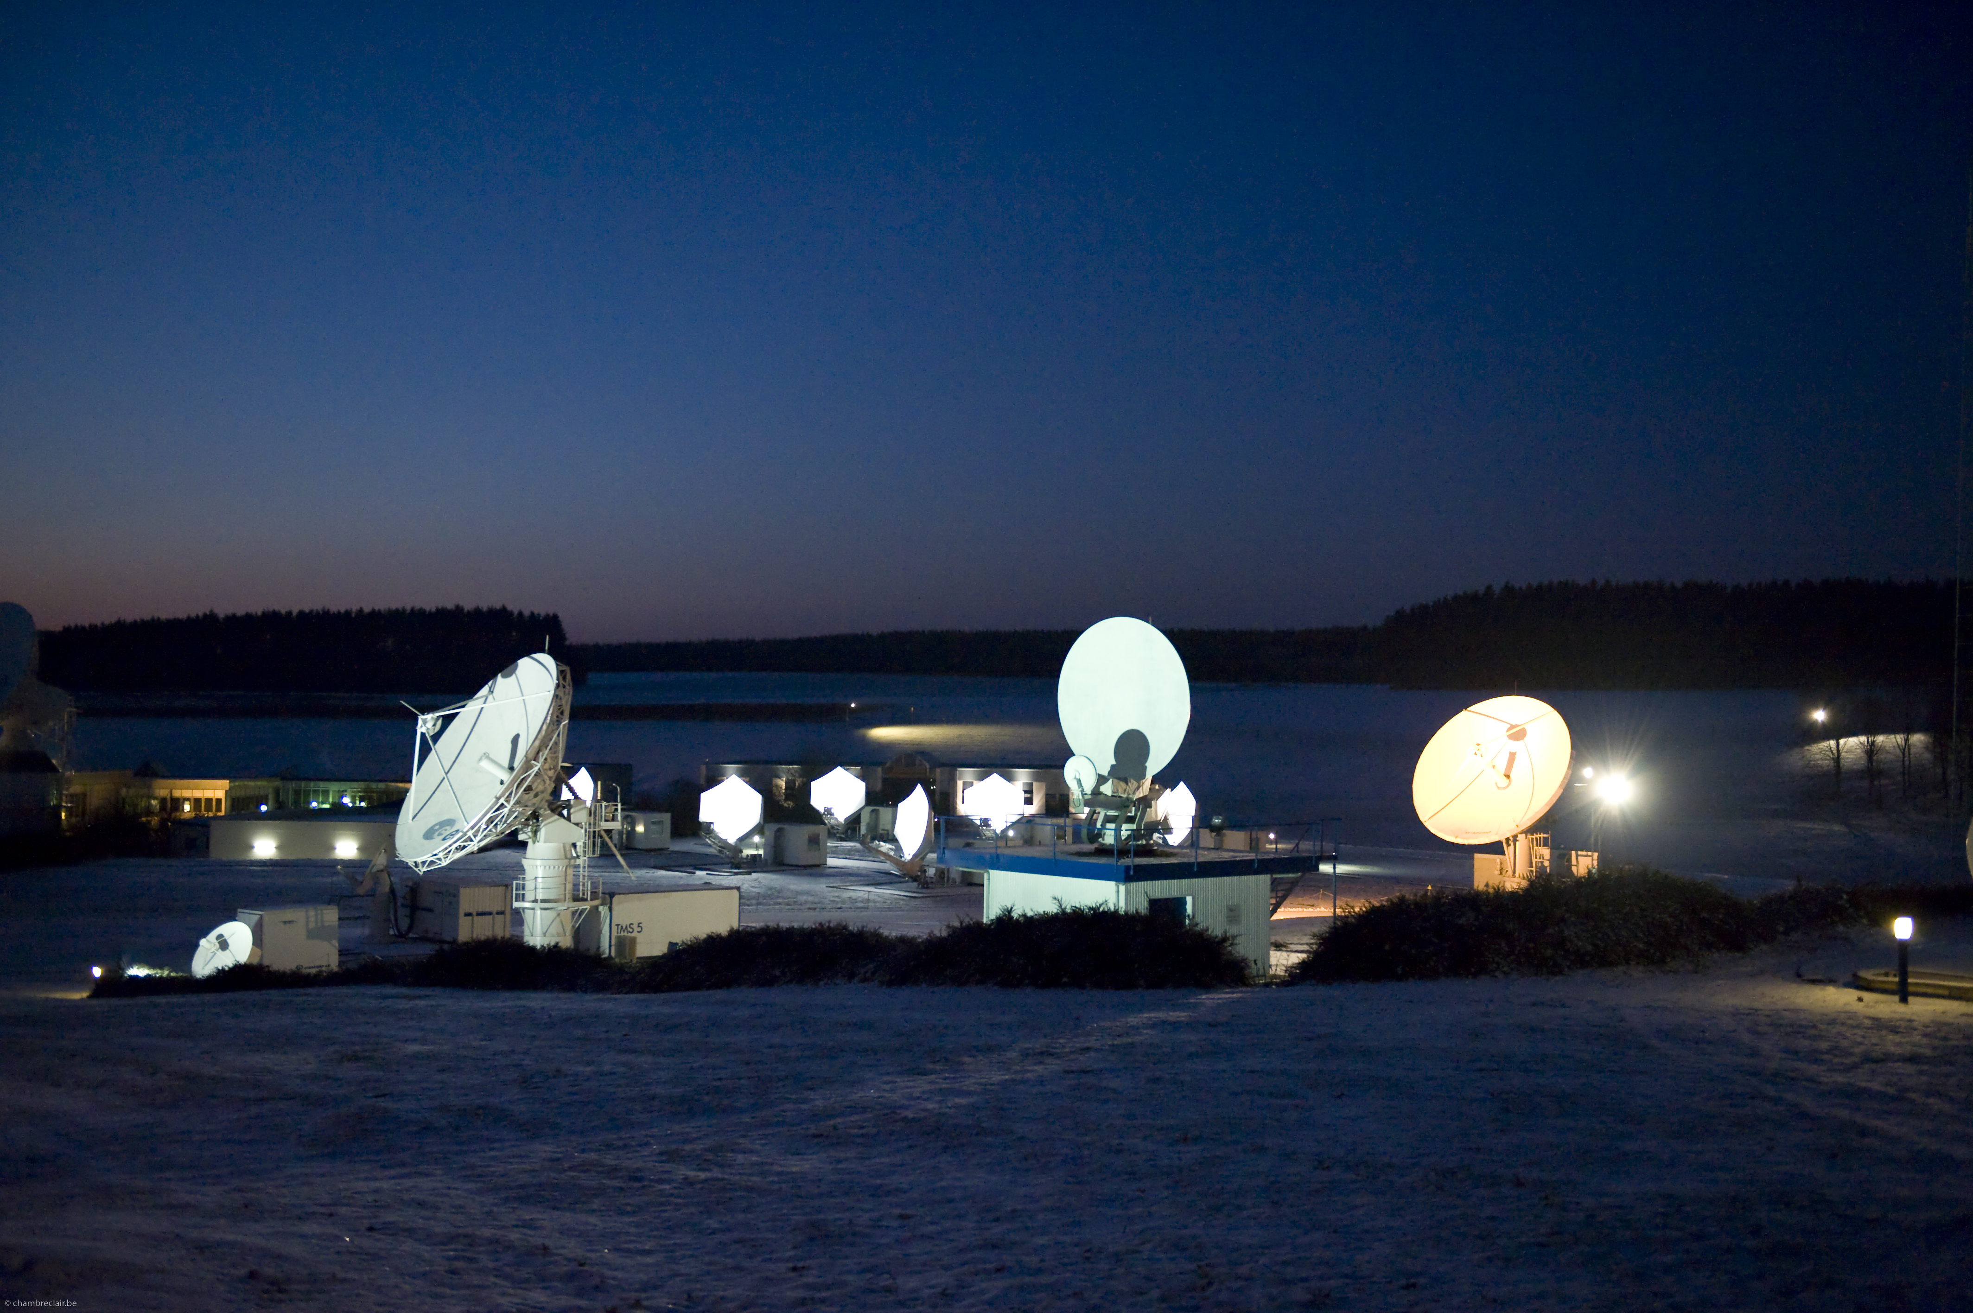
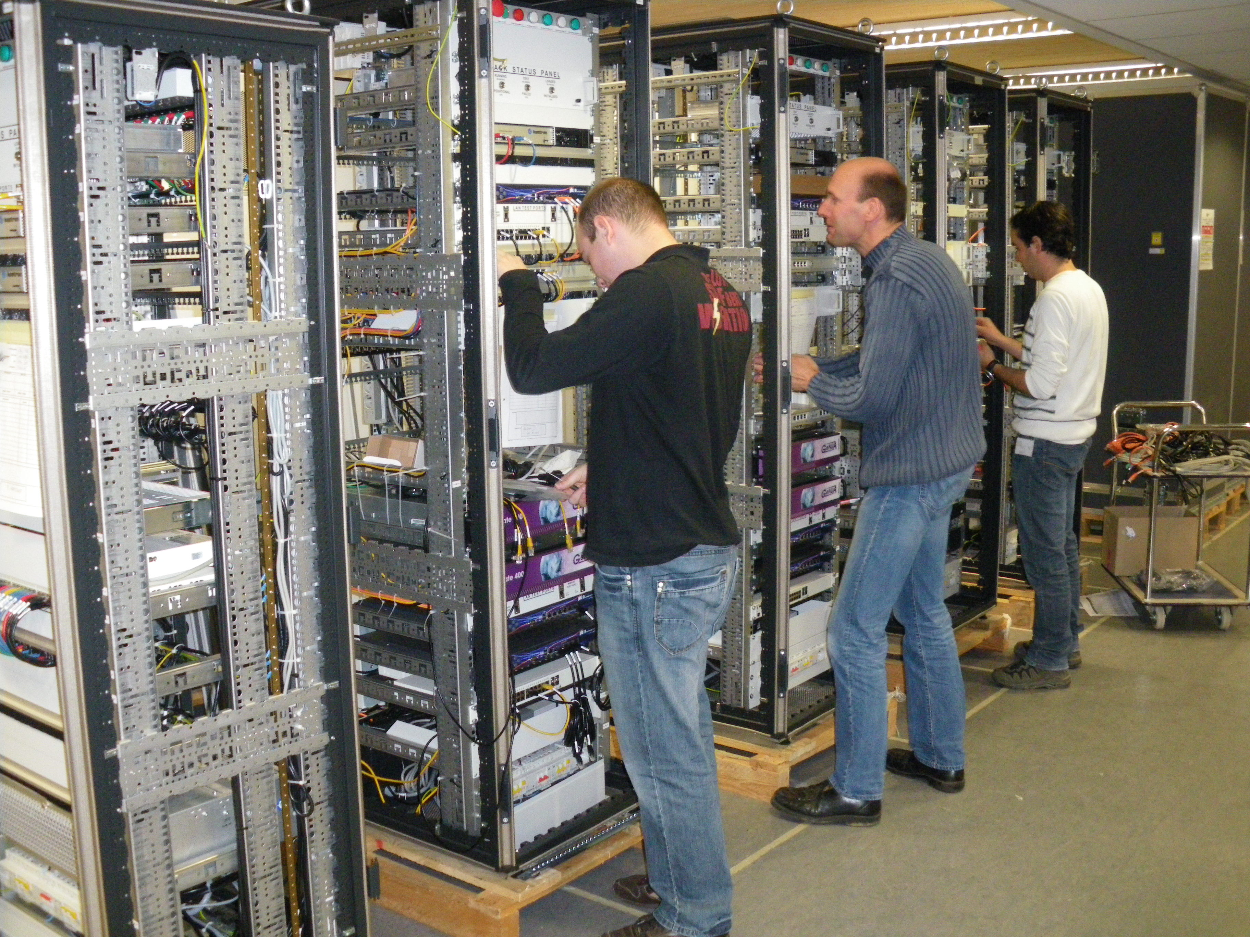
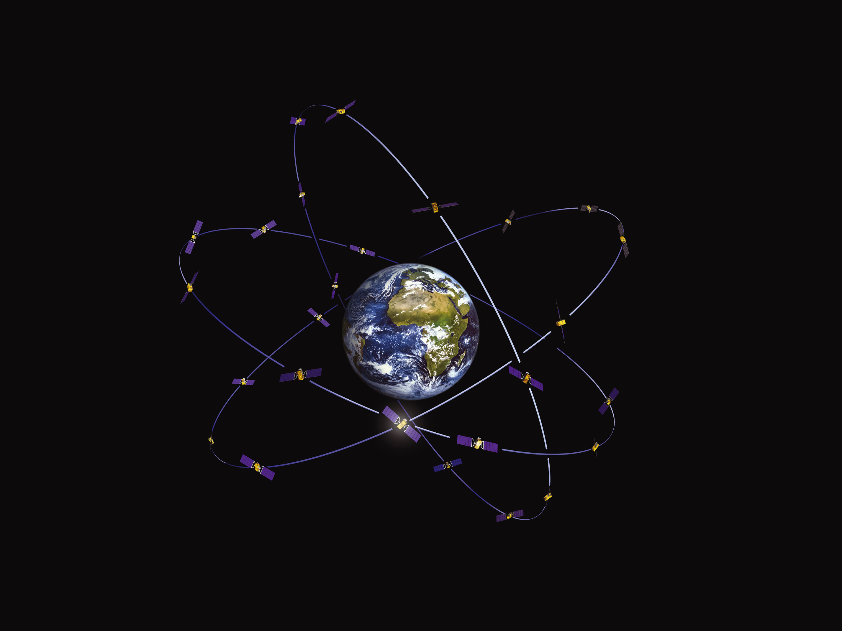
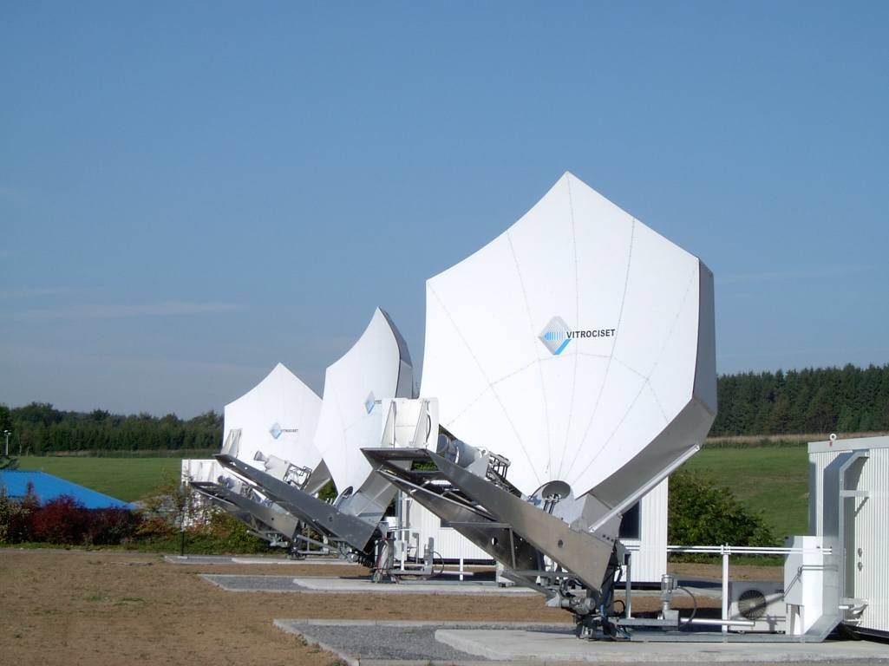
SPACE activities
Exploitation
Satellite operations (Proba Operations, SES Back up facility, Galileo (IOV and FOC), ..)
ESA - Redu, Redu Space Services, Virtociset Belgium

Slide 16
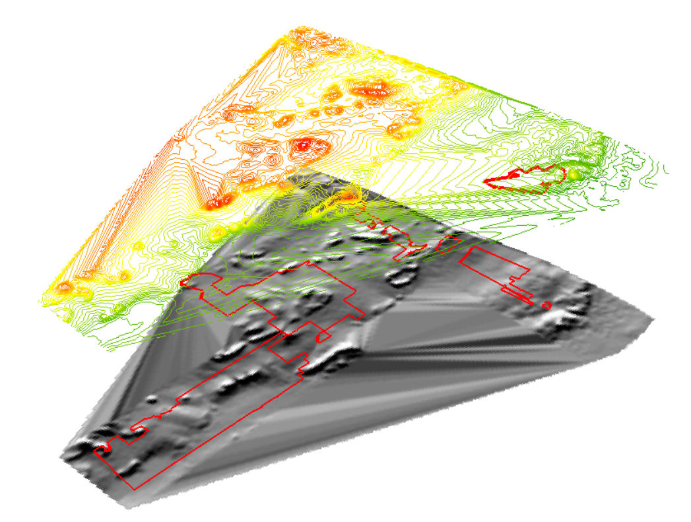
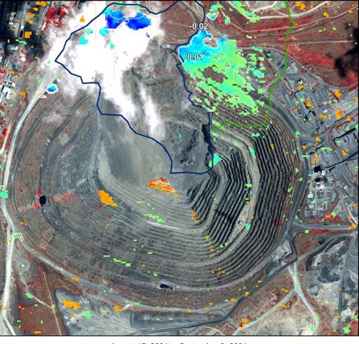
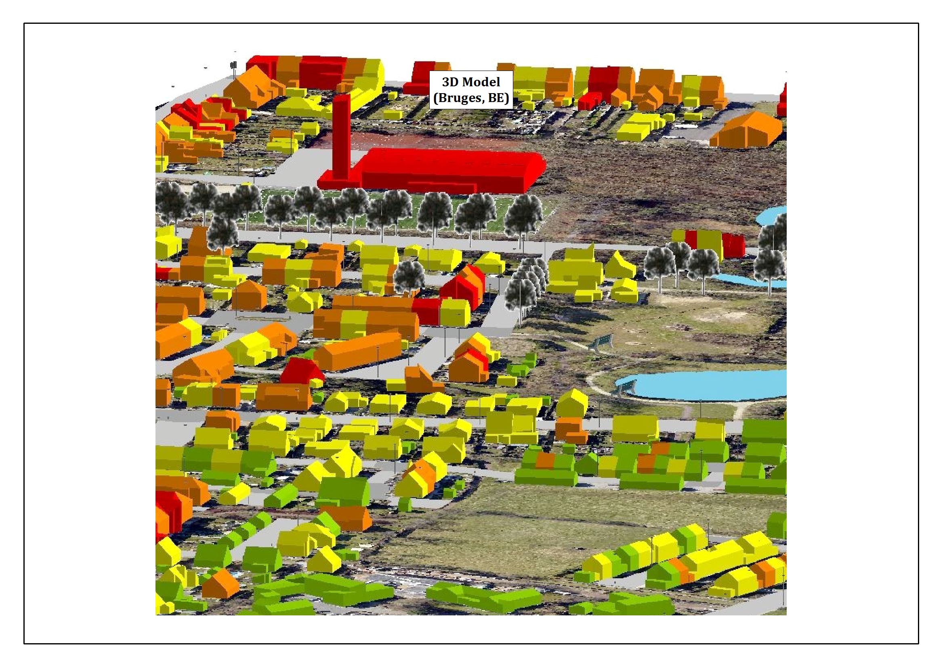
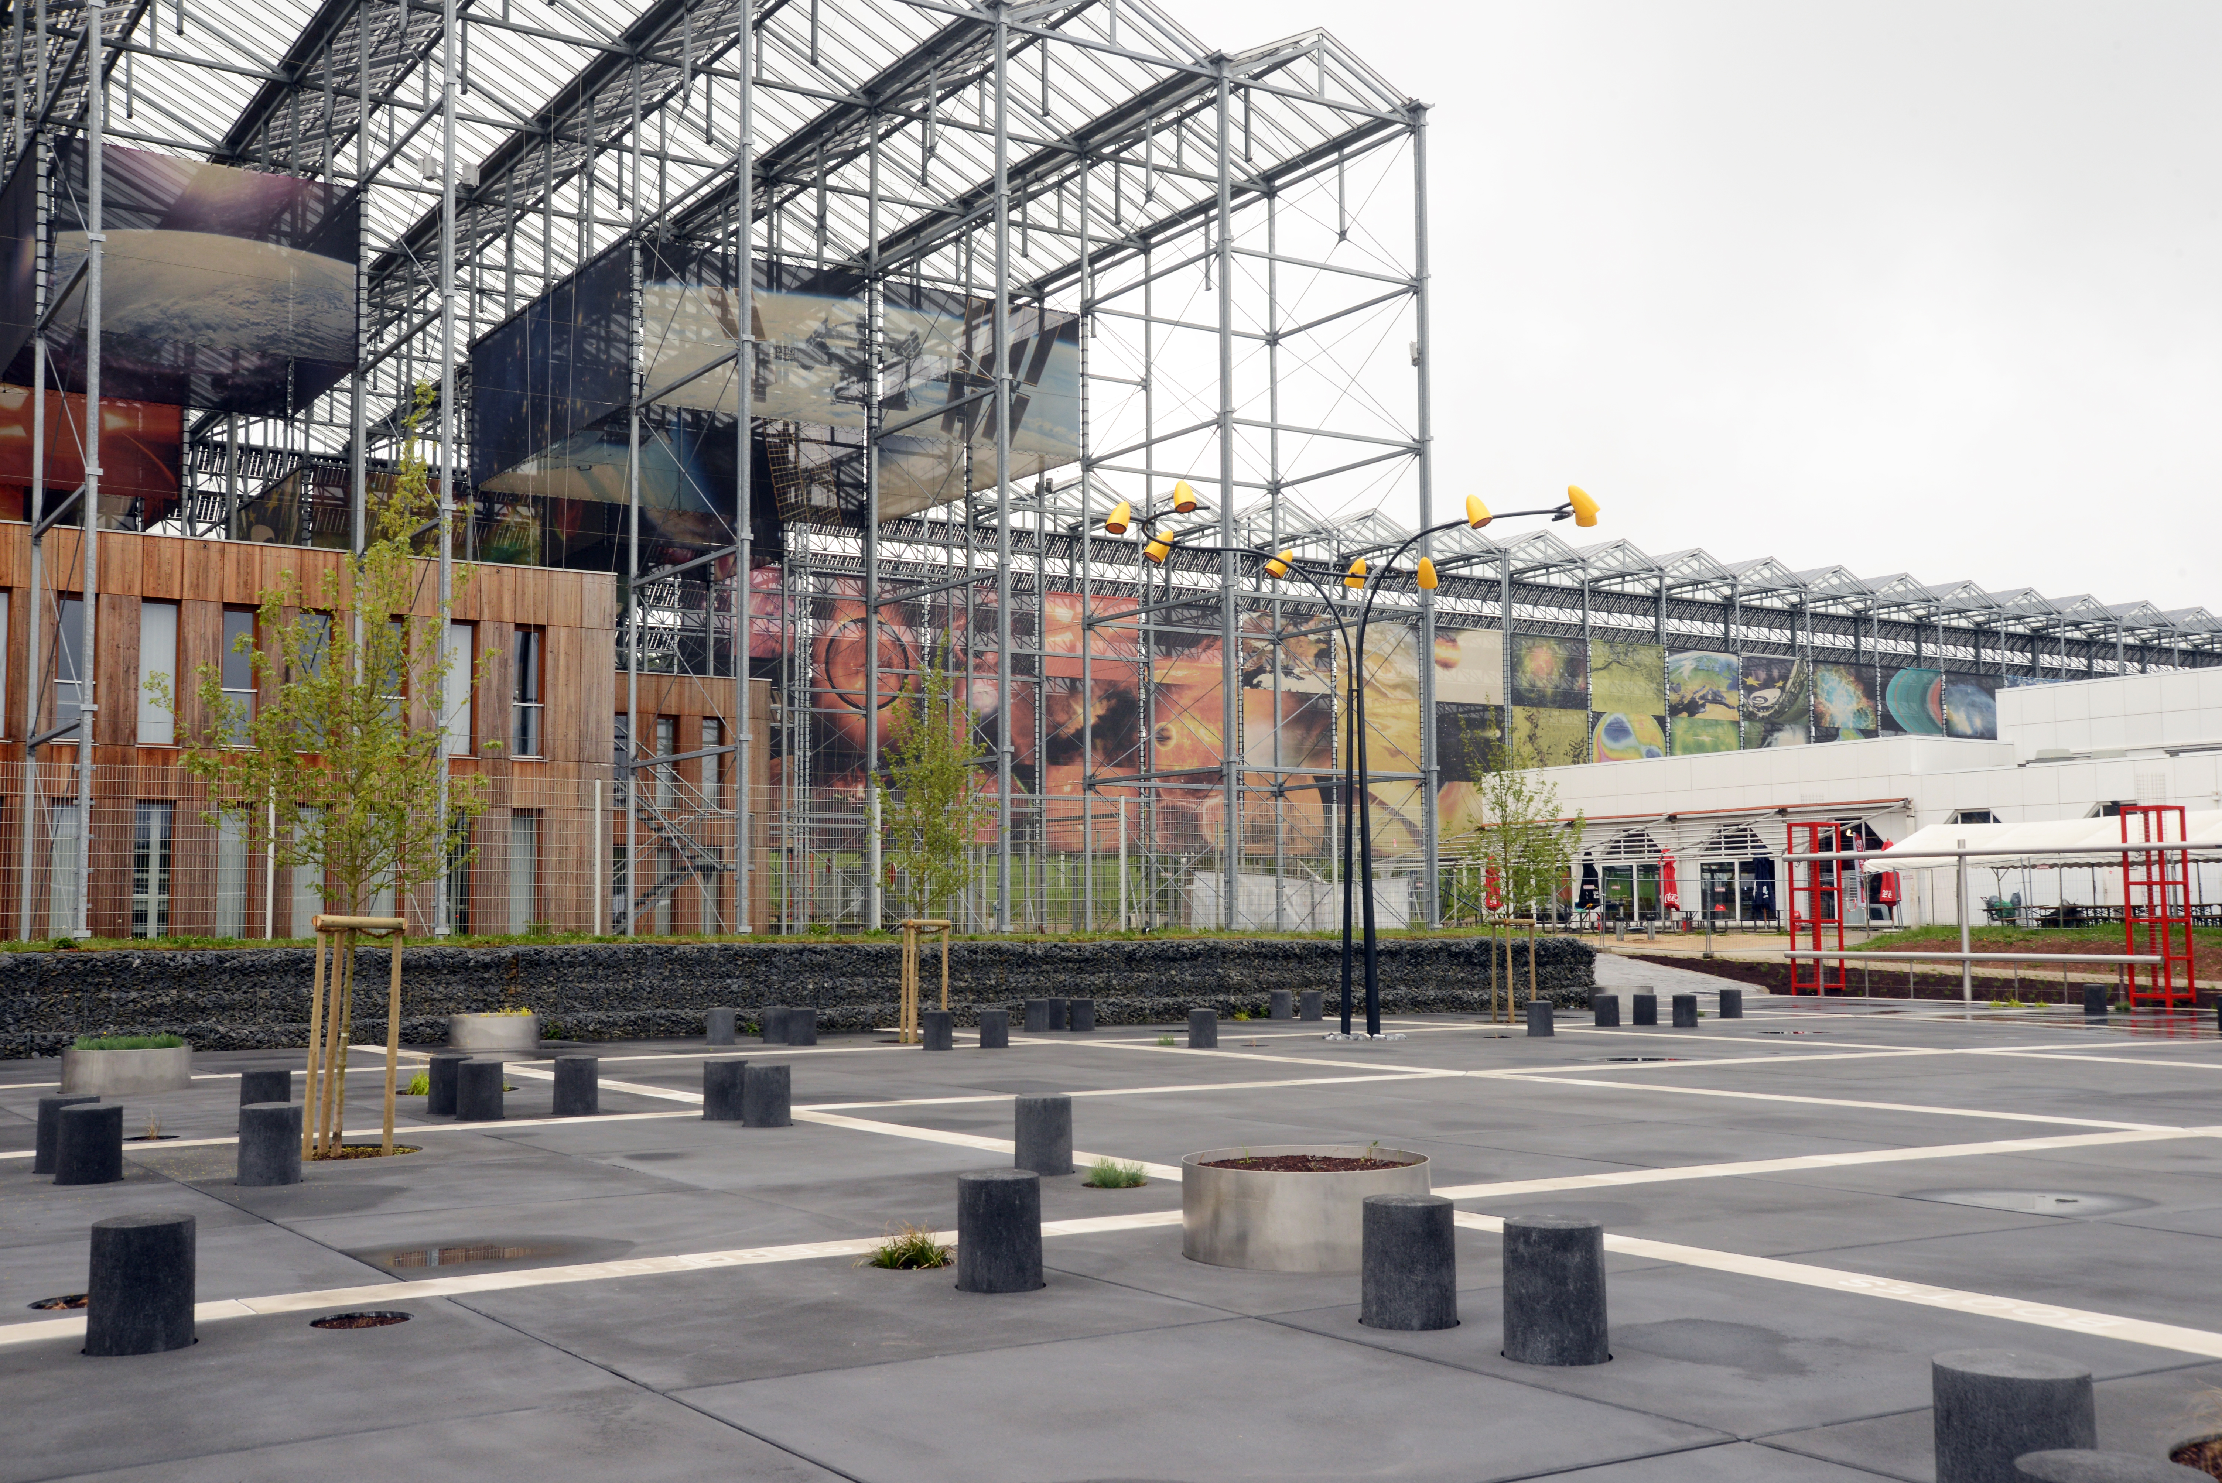

SPACE activities
Space applications and technology transfer
Earth observation, Satellite navigation, Telecommunications
Vitrociset Belgium, Spacebel, RMA, Walphot, CRA-W, GIM, M3 systems, ISSeP, Oscars,…
SME incubators & Tech transfer
WSL, ESA BIC Redu, Creaction

Slide 17



SPACE activities
Space education, Science & Astronomy
“Edutainment”
Euro Space Center
Universities (Up to 60 departments) - Masters and student’s nano-satellites
ULg (nanosatellites)
UCL, ULB
Astronomy
AMOS, ULg

Slide 18

International R&D projects
From April 2014 (Walloon Decree 2014, March 12)
These projects are now open for international cooperation :
  1 Walloon company (SME) + 1 International company
  1 Walloon University/Research Center + 1 International University/Research Center
  Same advantage for Walloon partners as previous “full walloon” consortium
  of course, international partners will not be funded by Walloon administration

Slide 19










International cooperation
Cooperation with aerospace clusters
MoU with AEROSPACE VALLEY (Midi-Pyrénées)
MoU with ASTECH (Île de France)
MoU with AERO MONTREAL (Québec)
MoU with CRIAQ (Québec)
MoU with Luxembourg Space Cluster (Luxembourg)
MoU with SIATI (India)
MoU with SAMARA (Russia)
MoU with Inmavis (Russia)
Member of EACP
(European Aerospace Clusters Partnership)
Member of NEREUS
(European Space Applications Networks)

Slide 20

Visit our website

